Slide 1

Hotel Booking Cancellation Analysis
ANLT601 – Coursework 20%
Prepared by: Ke Zhang
Student ID: 000541779
Date: MAR. 23, 2025

Slide 2

Contents / Agenda
Problem Definition
Data Dictionary
Business Problem Overview and Solution Approach
EDA Results
Conclusions and Recommendations

Slide 3

Business Problem Overview and Solution Approach
🧩 Problem Statement:
INN Hotels, a hotel chain in Portugal, is currently facing a significant challenge with a high volume of booking cancellations and no-shows.
These cancellations, particularly last-minute ones, result in revenue loss, inefficient room utilization, and increased operational costs.
🧠 Solution Approach:
In order to address this issue, we will conduct a structured Exploratory Data Analysis (EDA) using Power BI.
The analysis will be divided into two phases:
Univariate Analysis to understand individual variables that might influence cancellations.
Bivariate Analysis to explore interactions between variables.
Based on the insights generated, we will propose actionable strategies to reduce cancellations and optimize booking policies.

Slide 4
Data Dictionary
1. Booking Details
Field | Description
Booking_ID | Unique ID for each booking
booking_status | Whether the booking was canceled or not
lead_days | Days between booking and arrival
market_segment_type | Booking source/channel (e.g., Online, Offline, Corporate)
arrival_year / month / date | Scheduled arrival time details
no_of_adults / children | Number of the guests

Slide 5
Data Dictionary
2. Guest Information
Field | Description
repeated_guest | 1 if guest has booked before, 0 otherwise
no_of_previous_cancellations | Count of past cancellations by the guest
no_of_previous_bookings_not_canceled | Count of past successful bookings
required_car_parking_space | Whether guest requested a parking space
no_of_special_requests | Number of special requests made (e.g., high floor)

Slide 6
Data Dictionary
3. Room & Price Details
Field | Description
room_type_reserved | Encoded room type selected by guest
avg_price_per_room | Average price per day (in euros)
no_of_weekend_nights | Weekend nights booked
no_of_week_nights | Weekday nights booked
type_of_meal_plan | Meal plan chosen (e.g., breakfast only, full board)

Slide 7
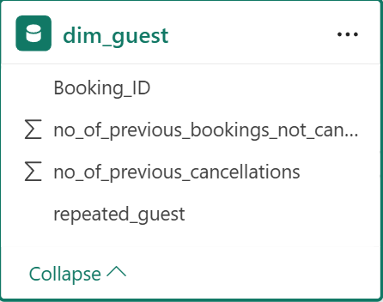
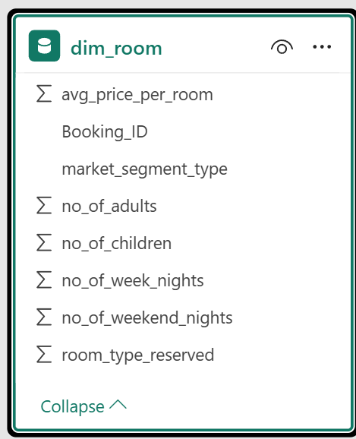
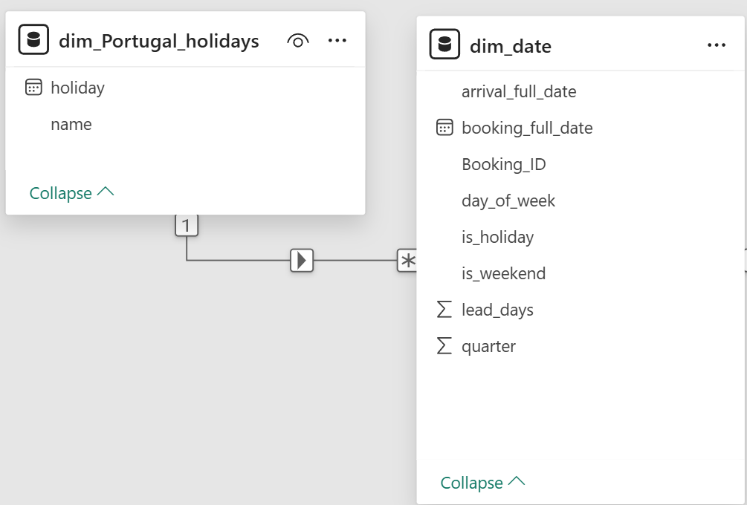
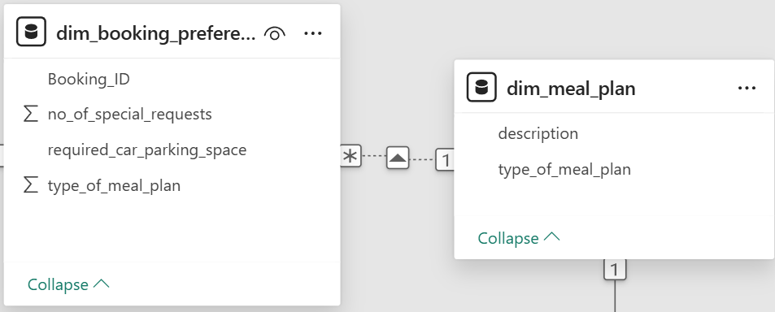
Data Dictionary
Dim Tables

Slide 8
Exploratory Data Analysis (EDA)

Slide 9
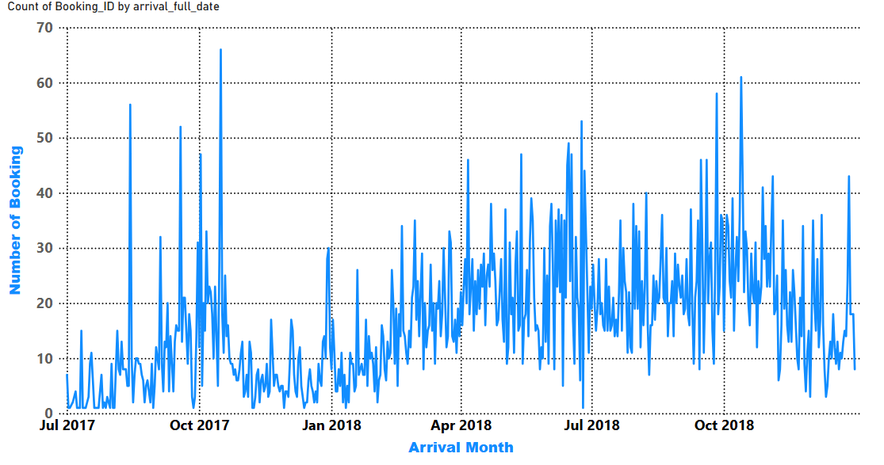
EDA – Univariate Analysis:
Strategies to effectively manage and accommodate the increased demand
Booking Trend by Date:
The booking trend over time shows a clear seasonal pattern, with demand starting to rise from early 2018 and peaking around August and October.
In contrast, there is significantly lower booking activity during winter months such as January and February.
These fluctuations suggest a strong seasonal demand, requiring the hotel to plan its resources accordingly.

Slide 10
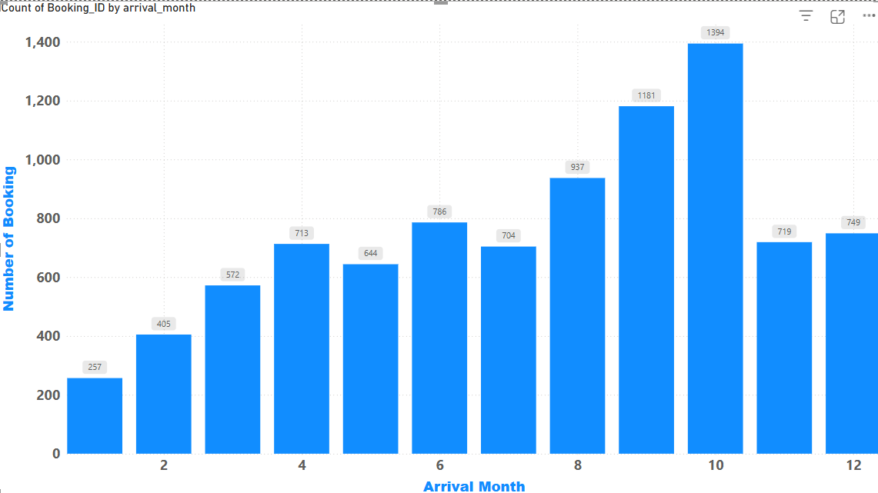
EDA – Univariate Analysis:
Strategies to effectively manage and accommodate the increased demand
Monthly Bookings :
The month-wise breakdown shows that bookings increase significantly between May and October, with October having the highest volume (1,394 bookings).

Slide 11
EDA – Univariate Analysis:
Strategies to effectively manage and accommodate the increased demand
To manage and accommodate the increased demand efficiently, the hotel can consider:
Staff Scheduling: Increase staffing during high-demand periods (May to October), especially for front desk and housekeeping.
Revenue Management: Implement dynamic pricing during peak months to maximize profit and control overbooking risk.
Promotions in Low Season: Launch targeted marketing for low-demand months (e.g., January–March) to balance occupancy, including meal plans or room services, and simply discount.

Slide 12
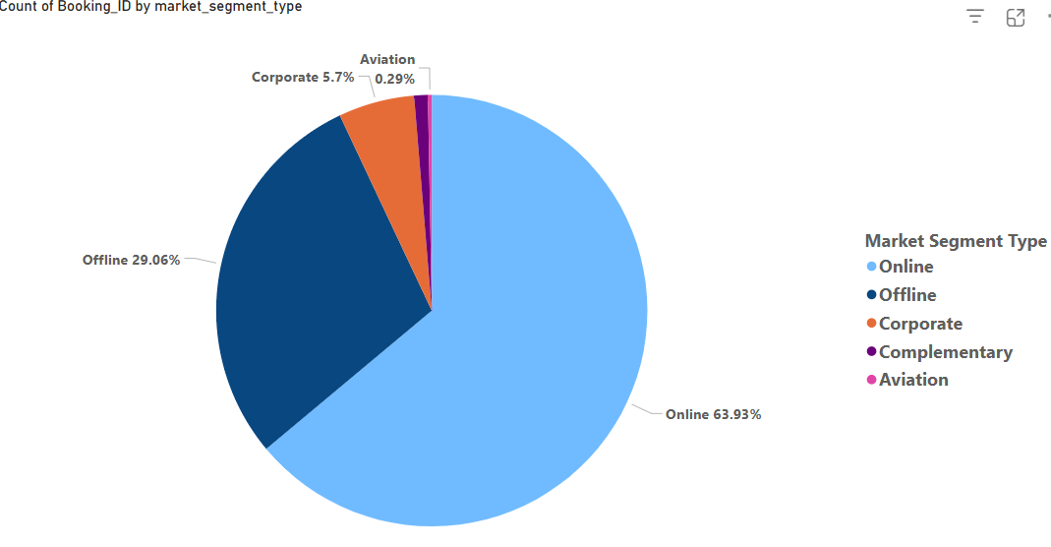
EDA – Univariate Analysis:
Percentage of bookings made online versus offline
Distribution of Booking Channels:
The pie chart shows that the majority of bookings (63.93%) were made through online channels, while offline channels accounted for 29.06%.
Other segments such as Corporate (5.7%), Complementary, and Aviation bookings contributed only marginally.
This indicates a heavy reliance on digital booking platforms, which could have implications for marketing strategies, partnership decisions, and commission management.

Slide 13
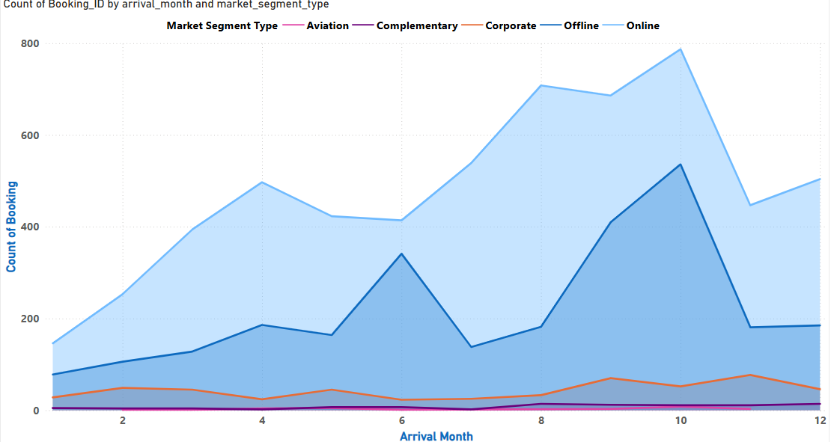
EDA – Univariate Analysis:
Percentage of bookings made online versus offline
Monthly Booking Trend by Channel:
The monthly trend analysis shows that online bookings dominate consistently throughout the year, especially during high-demand months (July to October).
Offline bookings remain relatively stable, while corporate bookings show a slight increase in late months (October–December), possibly due to business travel.
Notably, online booking volume fluctuates more widely, suggesting it is more responsive to seasonal demand or marketing activity.

Slide 14
EDA – Univariate Analysis:
Percentage of bookings made online versus offline
The hotel can consider the following strategies:
Strengthen the hotel’s online booking infrastructure (website, mobile, OTA partnerships) to further support the dominant customer behavior..
Introduce targeted promotions during low-demand months to boost both online and offline bookings.
Consider diversifying marketing efforts to grow direct corporate and offline bookings, which may be more stable and less prone to cancellations.
Monitor cancellation rates by channel in further analysis to assess reliability.

Slide 15
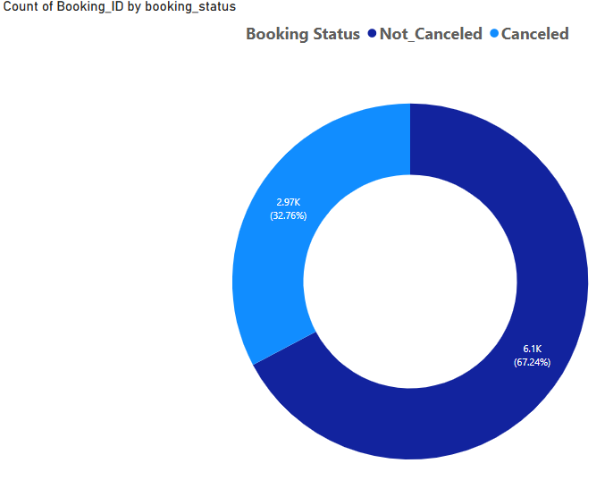
EDA – Univariate Analysis:
Percentage of bookings are cancelled
Overall Booking Cancellation Rate:
The overall cancellation rate is 32.76%, meaning nearly 1 in 3 bookings were canceled.
This is a significant operational and financial concern, especially when cancellations occur close to the arrival date, making it difficult for the hotel to resell the rooms.

Slide 16
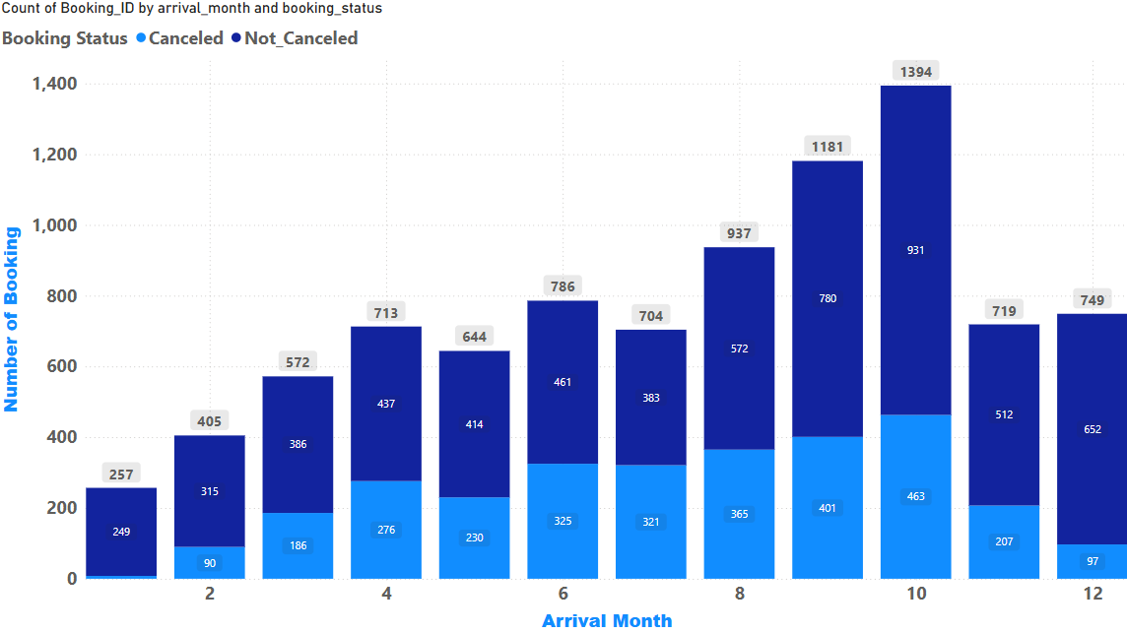
EDA – Univariate Analysis:
Percentage of bookings are cancelled
Monthly Bookings with Cancellations:
The month-wise breakdown shows that bookings increase significantly between May and October, with October having the highest volume (1,394 bookings).
Cancellations are also more frequent during these high-demand months, particularly in August, September, and October.
This indicates not only increased demand but also higher uncertainty in room occupancy during these periods.

Slide 17
EDA – Univariate Analysis:
Percentage of bookings are cancelled
The overall cancellation rate is 32.76%, which indicates a major operational concern.
Cancellation volumes rise sharply during the peak months of July to October, making this issue even more critical during high-demand periods.
To mitigate the impact of cancellations, the hotel should consider:
Implementing stricter cancellation policies, especially for bookings made during peak seasons.
Encouraging non-refundable bookings through price incentives.
Introducing partial deposits or advance payments.
Using data analytics to predict and flag potential cancellations in advance.

Slide 18
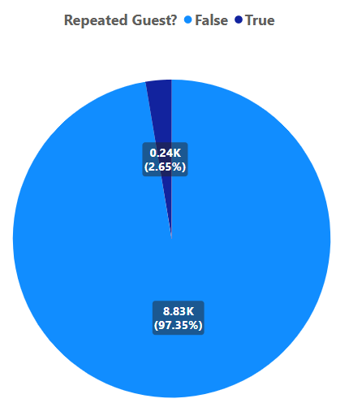
EDA – Univariate Analysis:
Repeated Guests
Repeated Guest Proportion:
The analysis reveals that only 2.65% of the hotel's bookings come from repeated guests, while 97.35% are new customers.
This suggests a low customer retention rate, indicating that the hotel may not be building long-term loyalty or brand attachment.

Slide 19
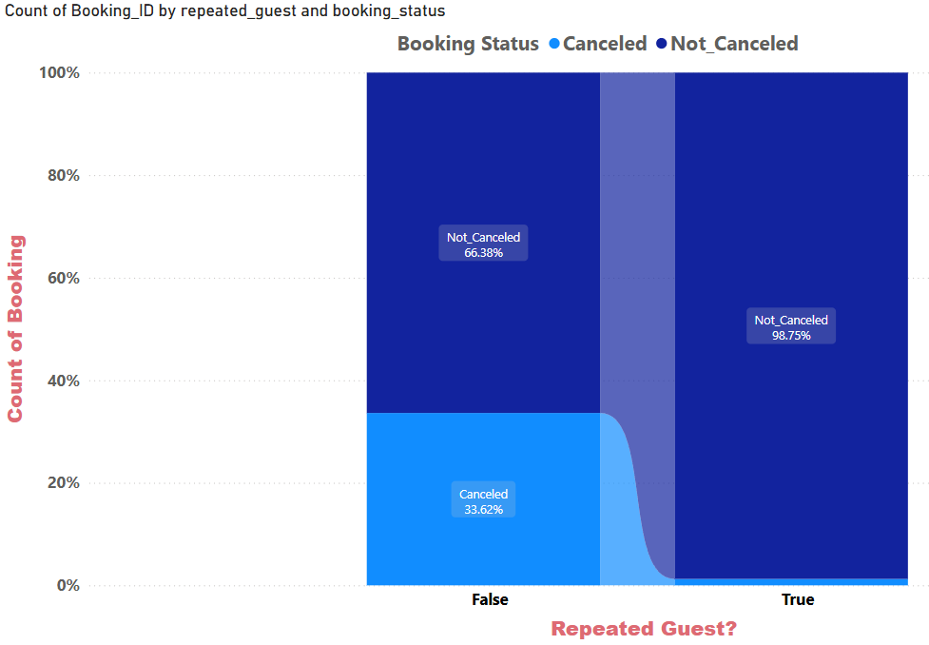
EDA – Univariate Analysis:
Repeated Guests
Cancellation Rate by Guest Type:
Among repeated guests, the cancellation rate is extremely low (1.25%), while new customers cancel at a much higher rate (33.62%).
This confirms that repeated guests are significantly more reliable, and efforts to retain customers can directly reduce the cancellation rate and improve revenue stability.

Slide 20
EDA – Univariate Analysis:
Repeated Guests
Suggested Strategies to Improve Guest Loyalty:
Launch a loyalty program: Offer points, discounts, or upgrades for repeat bookings.
Send post-stay emails and personalized offers to encourage return visits.
Reward low-risk customers, such as those with no past cancellations, with more flexible booking options.
Track satisfaction scores of repeated guests to understand retention drivers.
Provide incentives for direct bookings, such as free breakfast or late check-out.

Slide 21
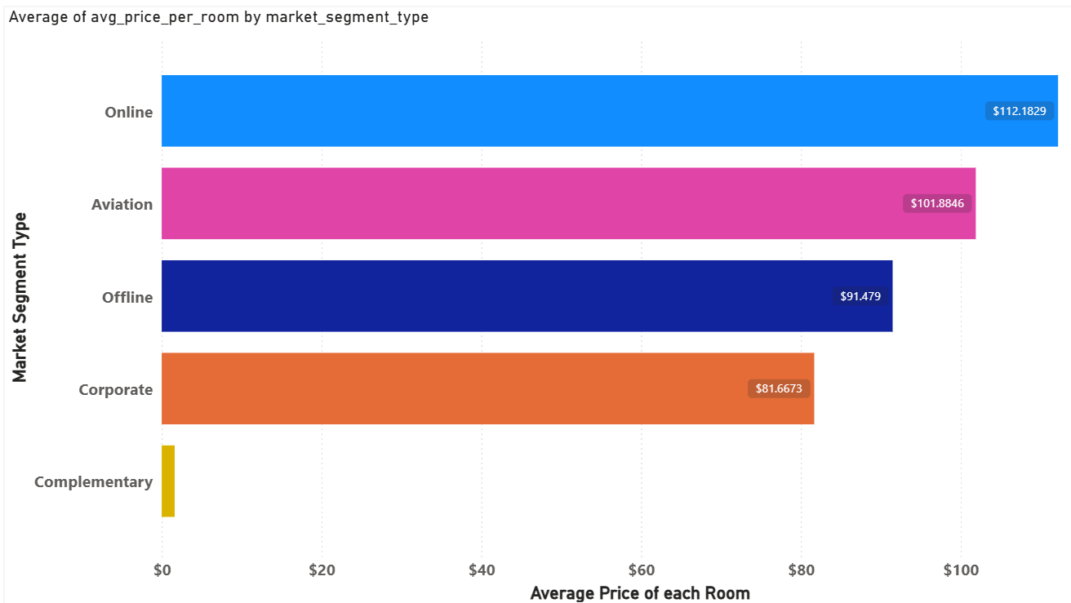
EDA – Univariate Analysis:
Optimize the revenue management strategies considering the significant price variations
Average Room Price by Market Segment:
The Online segment shows the highest average room price at $112.18, followed by Aviation ($101.88) and Offline ($91.48).
The Corporate segment is lower than expected at $81.67, and Complementary is almost negligible ($1.62), likely due to free or promotional bookings.

Slide 22
EDA – Univariate Analysis:
Optimize the revenue management strategies considering the significant price variations
Summary:
The bar chart comparing average room prices by market segment reveals that Corporate and Online Direct channels have the highest average prices, while Offline, Complementary, and Aviation segments are associated with lower price points.
This suggests that revenue optimization efforts should prioritize high-yield channels, while lower-value segments could be targeted with upsell offers or limited availability during peak seasons.
Recommendations:
Allocate more rooms to high-paying segments (Corporate, Online Direct)
Restrict low-yield segments during high-demand periods
Offer value-added packages to boost revenue from low-price segments
Re-evaluate channel performance in combination with cancellation rates
Consider dynamic pricing per segment based on demand patterns

Slide 23
Results EDA – Univariate Analysis:
Summary:
Booking Trend:
Booking volume increases during peak seasons (July–October), indicating strong seasonal demand. However, this period also sees higher cancellation volumes.
Cancellation Rate:
The overall cancellation rate is high at 32.76%, with a significant number of high-value bookings being canceled—particularly from online and offline segments.
Guest Loyalty:
Only 2.65% of bookings are from repeated guests. However, they have an extremely low cancellation rate (1.25%), making them highly reliable customers.
Booking Channels:
The majority of bookings come from online sources (63.93%), which also exhibit the highest cancellation tendencies. Offline bookings show similar patterns.
Revenue by Segment:
Online and Aviation yield the highest prices.
Corporate is stable but moderately priced.
Complementary brings little to no revenue.
Canceled bookings often have higher average prices than completed ones—posing a revenue leakage risk.
Overall Insight:
High cancellation rates, low customer retention, and revenue loss from volatile segments (especially online) highlight key operational risks.
At the same time, stable high-value segments like Corporate and loyal guests offer strong opportunities for strategic focus.

Slide 24
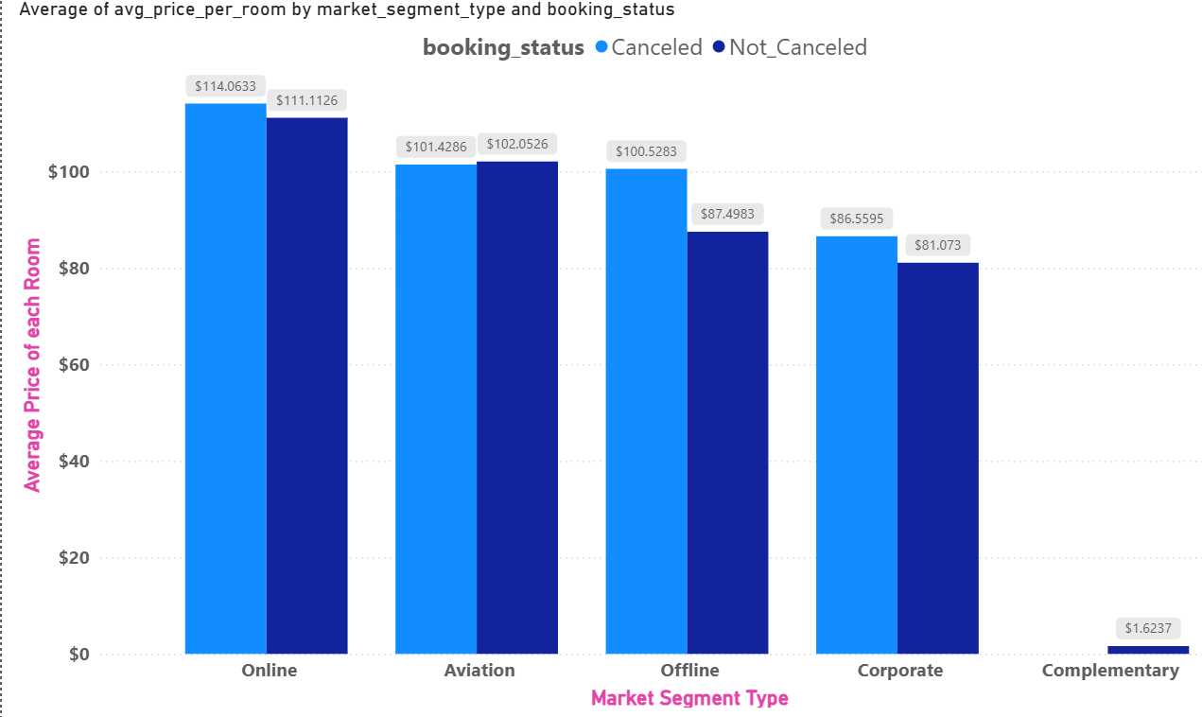
EDA – Bivariate Analysis:
Cancellations across different booking channels
Deeper analysis reveals an important insight:
In the Online and Offline segments, the canceled bookings have higher average prices than the non-canceled ones:
Online: Canceled $114.06 vs Not_Canceled $111.11
Offline: Canceled $100.53 vs Not_Canceled $87.50
This suggests that high-value bookings are more prone to cancellation, especially via OTA or agent-based channels.
Corporate bookings have lower cancellation prices, showing more stability.

Slide 25
EDA – Bivariate Analysis:
Cancellations across different booking channels
Summary:
High-priced bookings in Online and Offline segments are more likely to be canceled, leading to revenue loss.
Corporate bookings, while moderately priced, are more stable and should be prioritized.
Strategies such as non-refundable rates, partial payments, and loyalty incentives can mitigate the financial risk of cancellations.

Slide 26
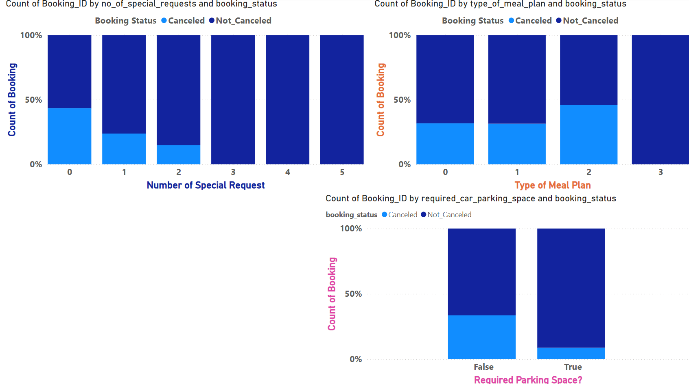
EDA – Bivariate Analysis:
The influence of requests on booking cancellations
1. Special Requests vs. Cancellation Rate
Guests with no special requests have the highest cancellation rate, nearly 45%.
As the number of special requests increases, the cancellation rate decreases significantly.
Guests who made 3 or more requests almost never cancel.
2. Required Parking Space vs. Cancellation Rate
Guests who require parking cancel far less (below 10%) compared to those who don’t.
The cancellation rate for guests not requiring parking is much higher, around 30%.
3. Meal Plan Type vs. Cancellation Rate
Bookings with Half Board (HB) (type 2) show the highest cancellation rate among all meal types.
Bookings with no meals (SC) or Full Board (FB) (type 3) are more stable.

Slide 27
EDA – Bivariate Analysis:
The influence of requests on booking cancellations
Recommendations:
1. Flag bookings with no special requests as high-risk, and consider:
Sending automated confirmation/reminder emails.
Offering discounts for selecting non-refundable options.
2. Treat customers who request parking or multiple services as high-value:
Offer loyalty benefits or priority check-in.
Target them with retention campaigns.
3. Re-evaluate pricing or policy for Half Board customers:
Encourage prepayment or deposit requirements.
Consider flexible upgrades to Full Board to improve booking commitment.
4. Build a behavioral risk profile:
Combine these variables to develop a “cancellation risk score” and apply tailored booking terms accordingly

Slide 28
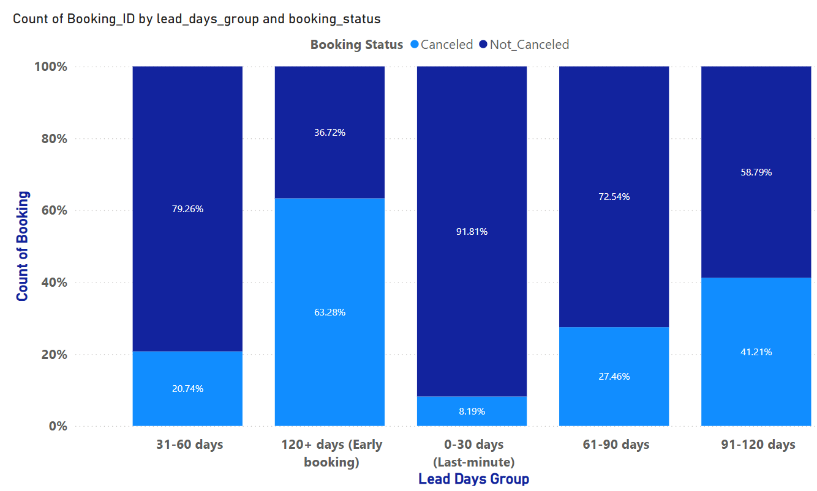
EDA – Bivariate Analysis:
The influence of lead time on booking cancellations
Interpretation of Lead Time vs. Cancellation Rate:
1. 0–30 days (Last-minute bookings):
Lowest cancellation rate (only 8.19%).
Indicates high reliability among late bookers.
2. 120+ days (Early bookings):
Highest cancellation rate (63.28%).
These customers are likely to change plans or book multiple hotels in advance
3. 91–120 days group also shows a relatively high cancellation rate (41.21%).
4. 31–90 days (intermediate groups):
Cancellation rates are moderate (~20–27%).
Insights & Implications:
The longer the lead time, the higher the chance of cancellation.
Shorter lead times correlate with more decisive and committed customers.

Slide 29
EDA – Bivariate Analysis:
The influence of lead time on booking cancellations
Recommendations:
Adjust Cancellation Policies by Lead Time:
For 120+ day bookings, enforce: Non-refundable rates or require a deposit or partial payment..
Send reminder emails to reconfirm intent 1–2 weeks before arrival.
2. Monitor and Forecast High-Risk Periods:
Use this insight to adjust availability and pricing dynamically for long-lead-time bookings..
Consider overbooking buffers for periods with high early booking cancellations.
3. Segment Campaigns Based on Booking Window:
Encourage last-minute bookings with targeted promotions, knowing these customers are more reliable.

Slide 30
Results EDA – Bivariate Analysis:
Summary:
1. Booking Channel vs Cancellation Rate:
Online bookings had the highest cancellation rate, while Offline and Corporate segments were more stable.
High-priced Online bookings with long lead times were more likely to be canceled.
2. Special Requests & Customer Needs:
Guests with more special requests, meal plans, or parking needs showed significantly lower cancellation rates.
Indicates these guests are more serious and committed to their stay.
3. Lead Time vs Cancellation:
Early bookings (120+ days) had the highest cancellation rate (63.28%).
Last-minute bookings (0–30 days) were the most reliable (only 8.2% canceled)
4. Monthly Patterns:
Cancellation rates varied across months, suggesting potential seasonal trends or holiday effects.

Slide 31
Recommendations:
Focus on Loyal & Low-Cancellation Segments
  Prioritize repeated guests, corporate, and offline segments with lower cancellation rates.
Implement Tiered Cancellation Policies
  Set stricter rules or penalties for early bookings and high-risk channels (e.g., online).
Enhance Booking Commitment through Add-ons
  Promote bookings with meal plans, parking, or special requests to reduce cancellation risk.
Use Lead Time Insights for Revenue Optimization
  Monitor lead days and create early-bird offers with controlled flexibility.
Address High-Season Volatility
  Prepare contingency plans for peak cancellation months (e.g., summer, October).
Introduce Loyalty & Incentive Programs
  Encourage return visits via discounts, referrals, or exclusive perks for loyal customers.
Strengthen Online Booking Management
  Use confirmation reminders, deposit requirements, or dynamic pricing for online channels.

Slide 32
Conclusions:
1. Identify Target Market & Booking Patterns:
Online bookings dominate, but also have the highest cancellation rate.
Corporate and Offline bookings are more stable and generate consistent revenue.
Repeated guests are extremely loyal and rarely cancel
2. Booking & Cancellation Trends Over Time:
High cancellation rates are observed in peak months (especially summer and fall).
Early bookings (120+ days in advance) have the highest cancellation probability.
Last-minute bookings (0–30 days) are more likely to be honored.
3. Financial Impact & Pricing Risk:
Channels like Online and Aviation have high average prices, but also high cancellation rates.
This leads to potential revenue loss and resource misallocation.
4. Customer Preferences & Cancellation:
Guests with special requests, meal plans, or parking needs are significantly less likely to cancel.
These customers demonstrate higher commitment and service sensitivity.
5. Customer Retention & Loyalty:
Repeated guests represent only 2.6% of total bookings, but account for less than 1.3% of cancellations.

